Slide 1
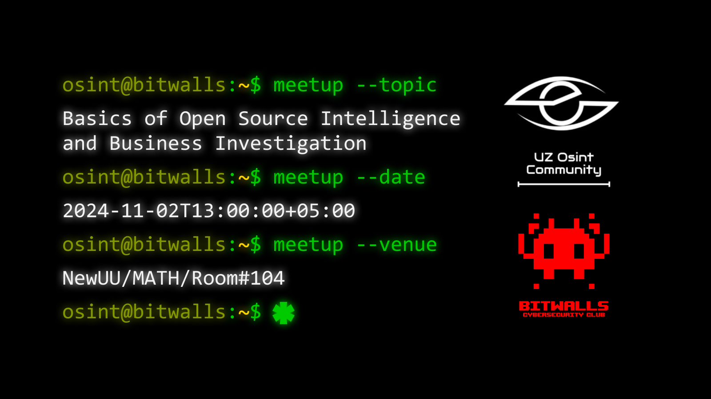

Slide 2

osint@bitwalls:~$ --whoami
The first OSINT community in Uzbekistan
Our main goals:
Promoting intelligence discipline
Unleashing the potential of OSINT for Uzbekistan and the Uzbek market
Development of counter-OSINT methods

Slide 3
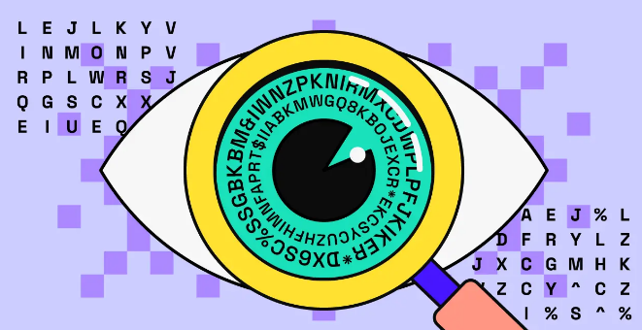
osint@bitwalls:~$ --agenda
Program for meetup:
What is OSINT?
Usage of intelligence
SocialMedia OSINT
Business Investigation and basic analysis
GEOSINT

Slide 4
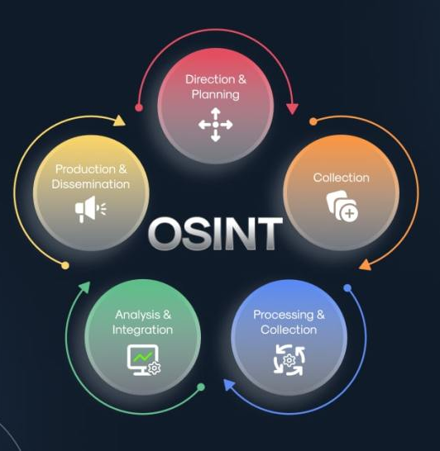
osint@bitwalls:~$ osint --help
What is OSINT?
Open-Source Intelligence is a discipline that contains 5 essential parts:
Information gathering
Processing data
Analysis
Reporting
Planning

Slide 5
osint@bitwalls:~$ osint --usage
Threat analysis
Competitors analysis
Criminalistics
HR
Cybersecurity
Business
PR
Security audition
OSINT
Analytics
Science
Searching for “missings”
Law and order
Press
Anti-terrorism
Crime investigations
Niche analysis

Slide 6


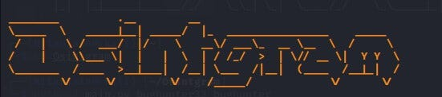

osint@bitwalls:~$ osint -cybersecurity
SOC
Threat hunting
Penetration testing
Data leak detection
Forensics

Slide 7
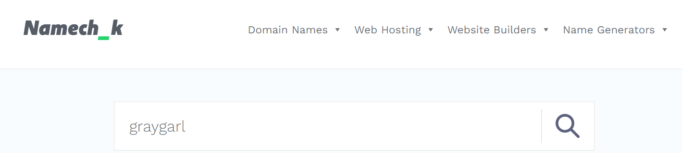
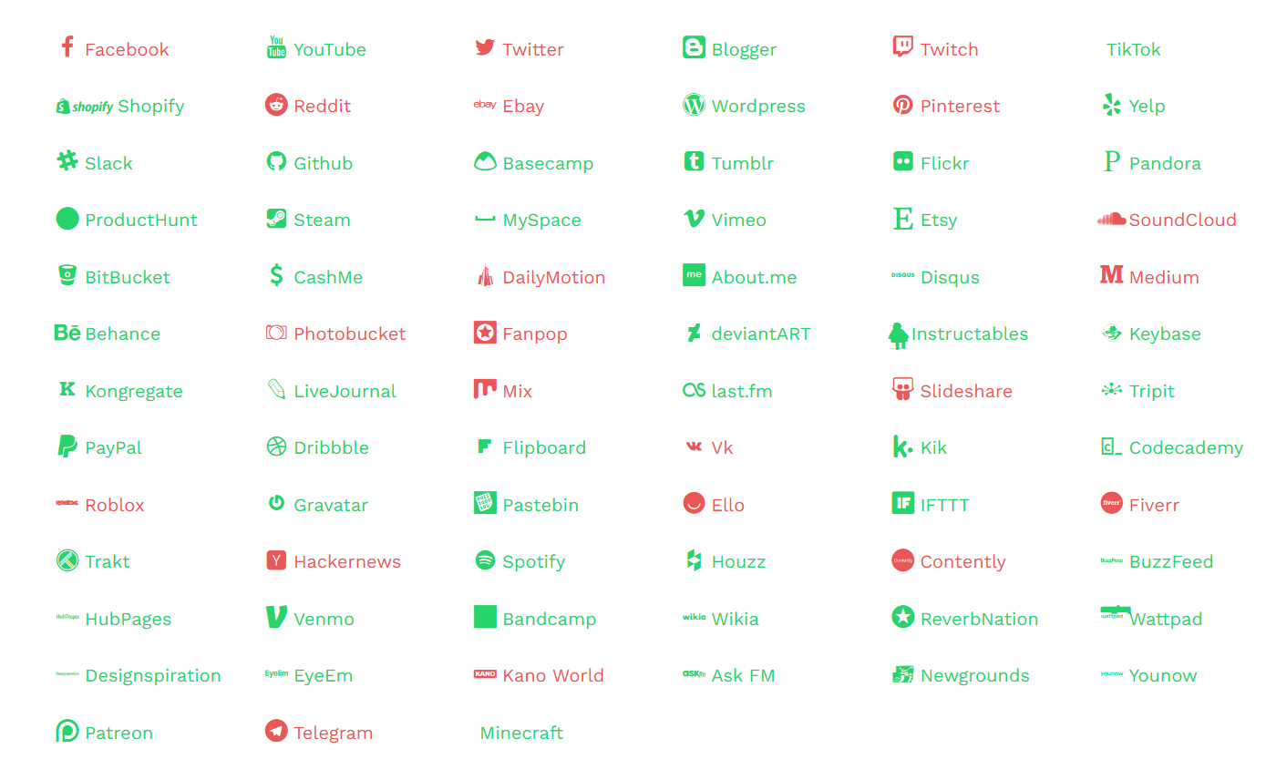
osint@bitwalls:~$ osint -SOCMINT
Social Media OSINT
Can be performed with many instruments and with any information (name, nickname, phone, email & etc)
Namech_k – web OSINT tool for searching by nickname

Slide 8
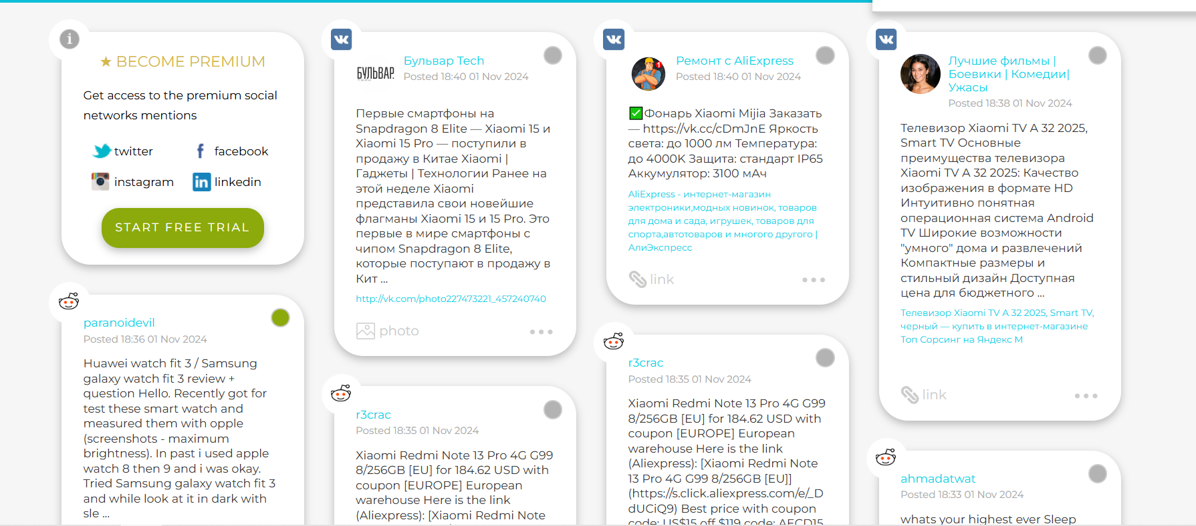
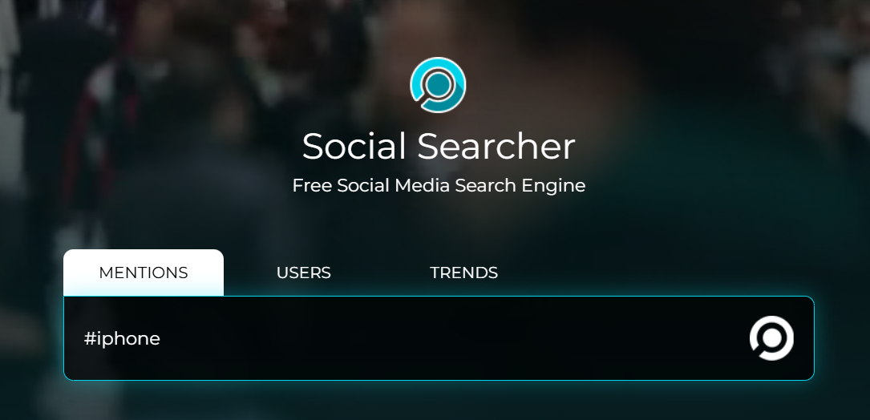
osint@bitwalls:~$ osint -SOCMINT
Social Searcher
Another OSINT web tool, it can search throw many platform for name/phone/trend
Mostly, it works better with Europe or USA

Slide 9
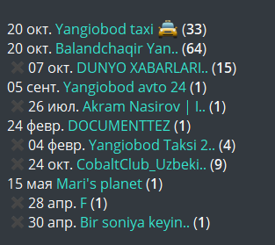
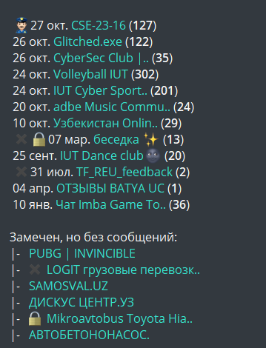
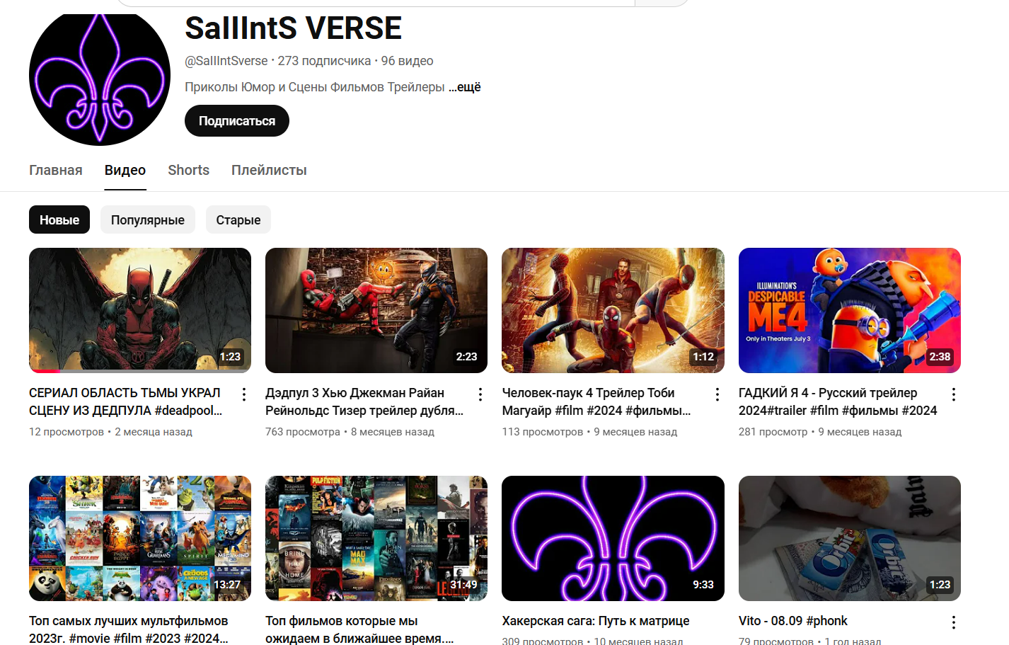
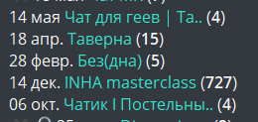
osint@bitwalls:~$ osint -business
HR Background check

Slide 10
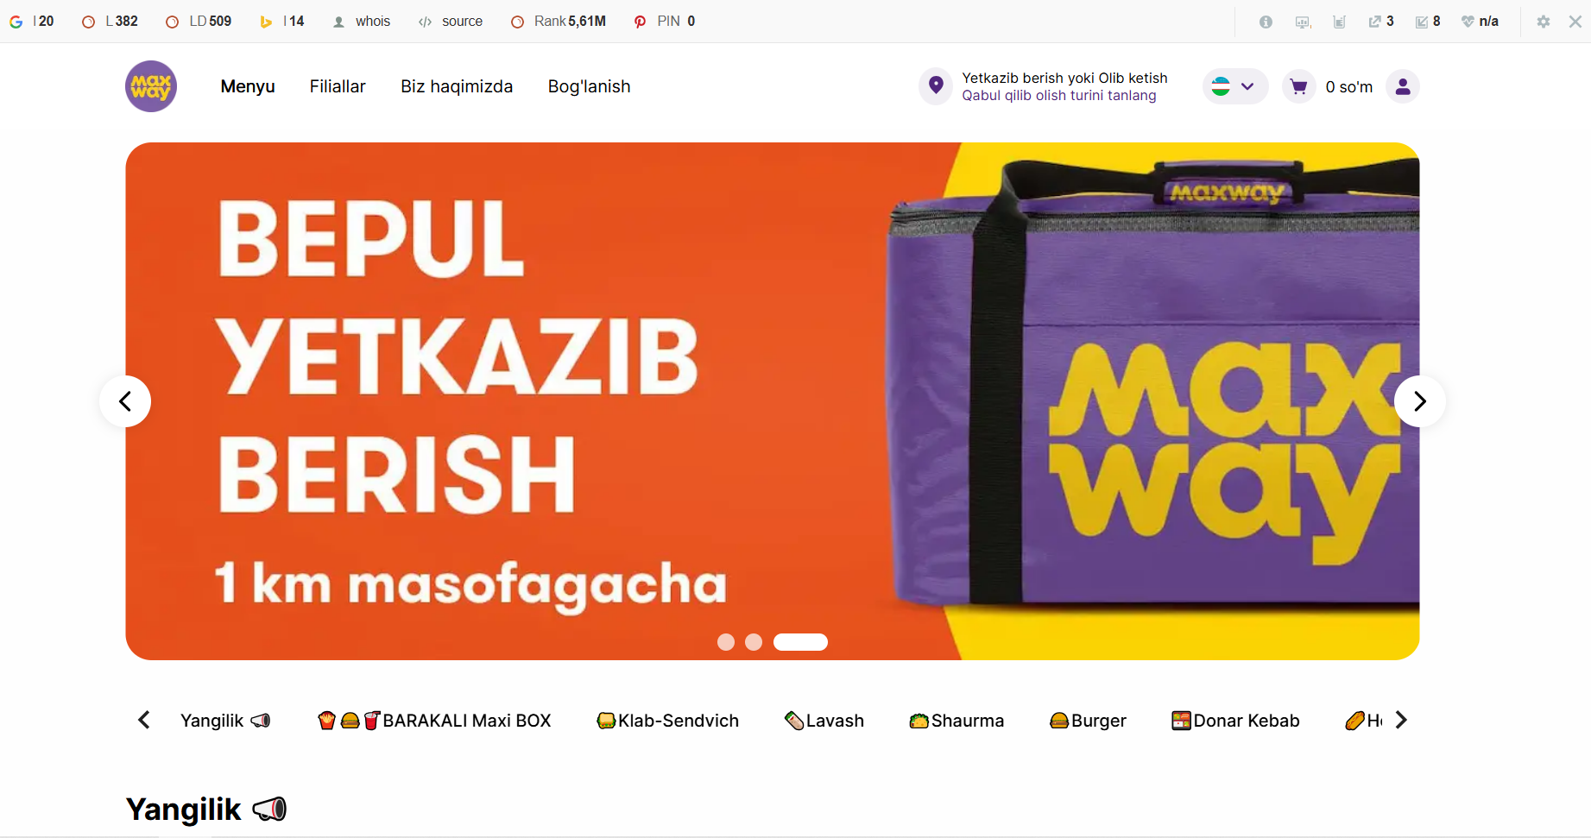
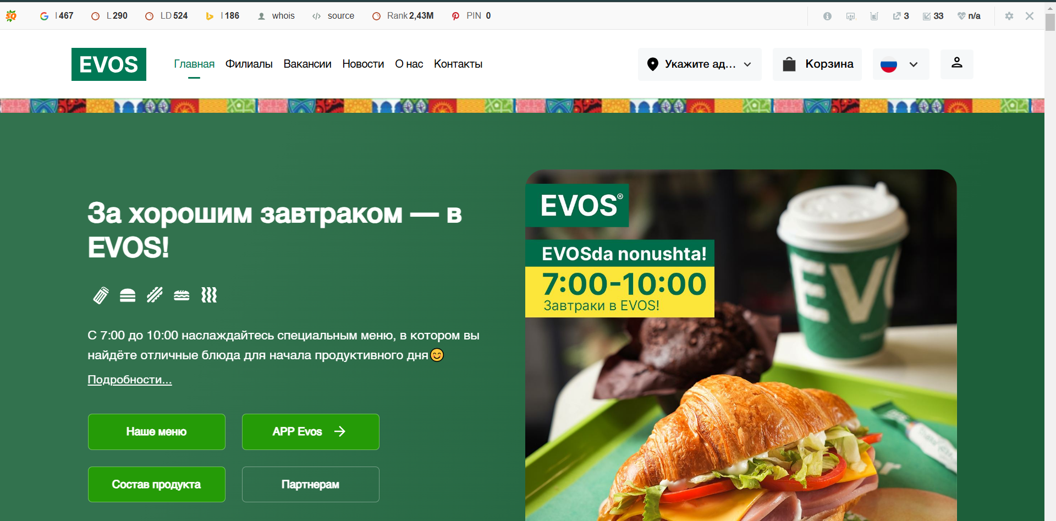
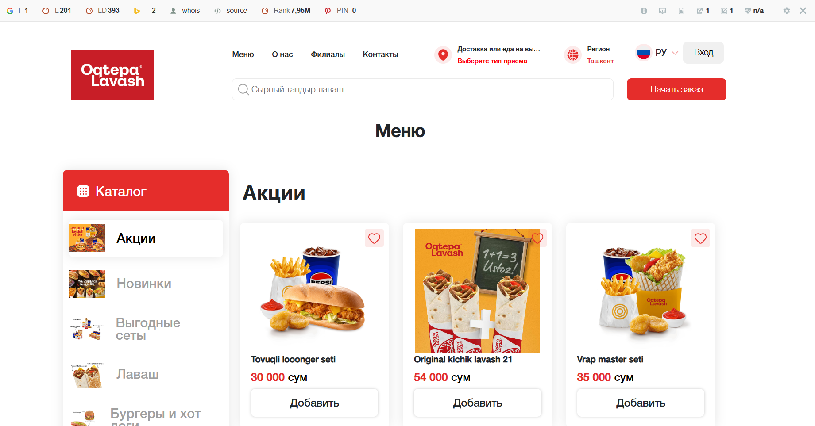
osint@bitwalls:~$ osint -business
Competitors analysis
It is usually based on comparison of:
Service
Assortment
SMM analysis

Slide 11

osint@bitwalls:~$ osint -business
Competitors analysis steps:
Choosing competitors
Analysis of USP
Analysis of website for p2p and b2b
Analysis of feedbacks
Analysis of social media
Analysis of sellings

Slide 12

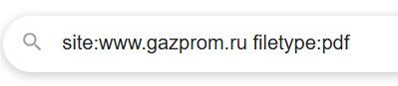
osint@bitwalls:~$ osint -business
Google dorks
1. Site Search:
- Query: site:example.com
2. File Type Search:
- Query: filetype:pdf
3. Inurl Search:
- Query: inurl:login
4 Allintext Search:
- Query: allintext:"text"

Slide 13
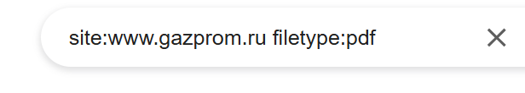
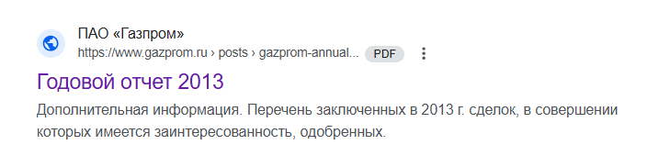
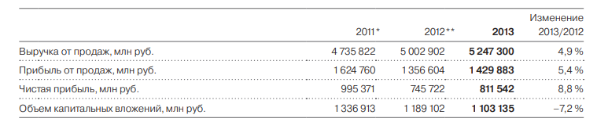
osint@bitwalls:~$ osint -business
The proper usage of Google dorks can make your work easier

Slide 14
osint@bitwalls:~$ osint –business -example
name | design | contacts | feedback | telegram | instagram | facebook
evos
maxway

Slide 15
osint@bitwalls:~$ osint -business
strength
weakness
SWOT analysis
good web design
Range of contacts
Easy access
New products
Good social medias
Bad feedbacks
Slow delivery
Bad work of the tg bot
Improve work of call center
Configuration of bots
Low quality of food
Problems with deliverymen
opportunities
treaths

Slide 16
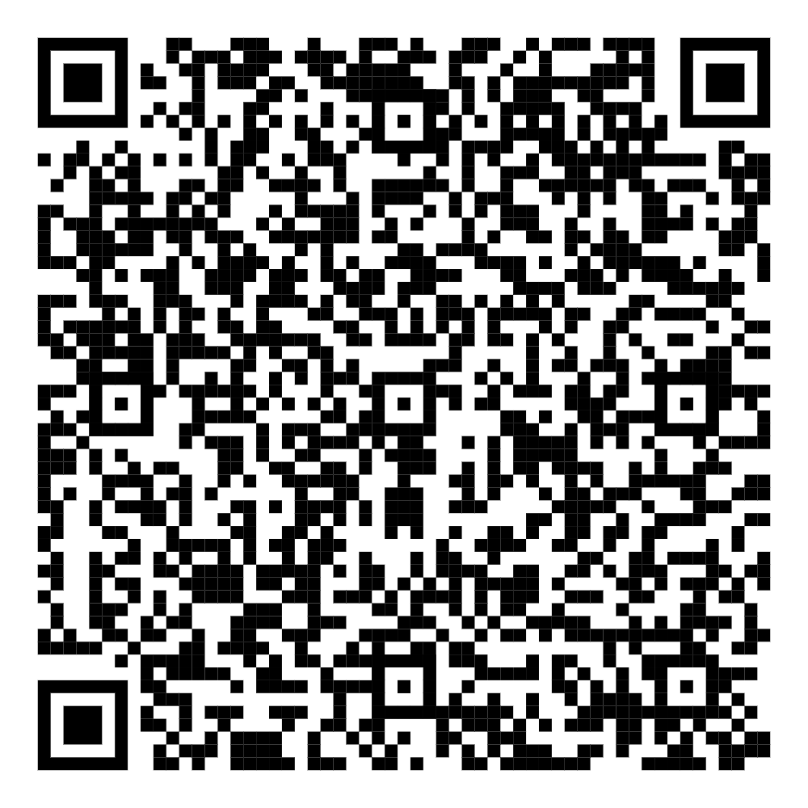
osint@bitwalls:~$ osint -analysis
В горах Сочи очень много красивых природных объектов. Один из них назван в честь гида, который открыл его в XXXX году во время работы инструктором.
А в YYYY году возле этого объекта была установлена памятная табличка?
Journalism
Scientific search
Niche analysis (mostly business, it can be used for statistic research)
For answer->
https://docs.google.com/forms/d/e/1FAIpQLScrX3JFX3gdcM6D9rLYlQaeMmRA6MtfOhOwoqkw3jFN45bDnw/viewform?usp=sf_link

Slide 17
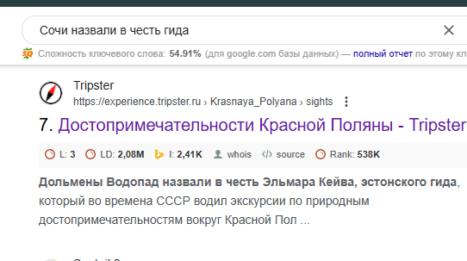
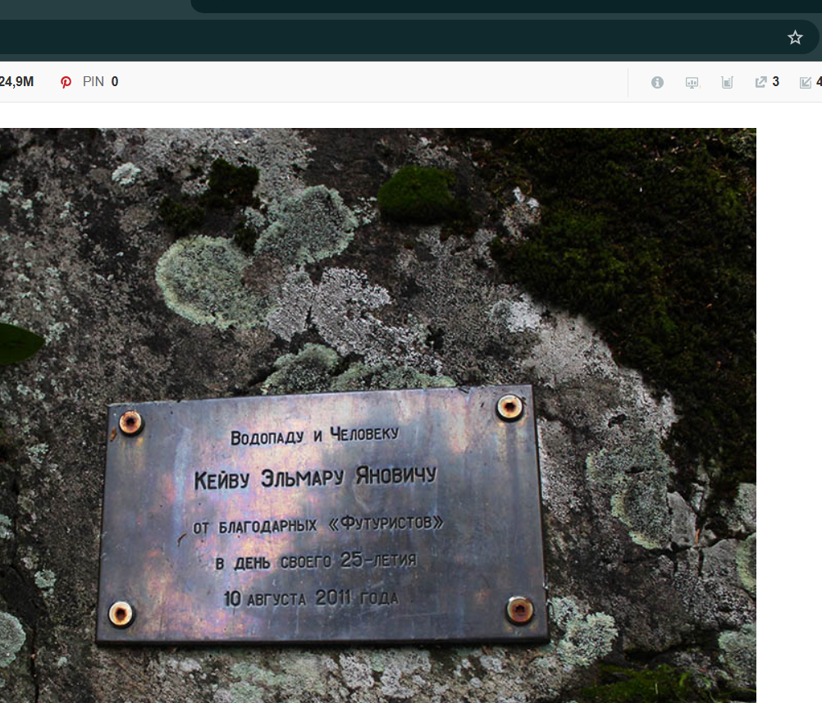
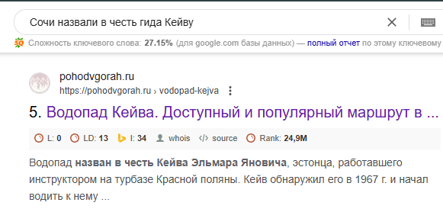
osint@bitwalls:~$ osint –analysis -solution
В горах Сочи очень много красивых природных объектов. Один из них назван в честь гида, который открыл его в XXXX году во время работы инструктором.
А в YYYY году возле этого объекта была установлена памятная табличка?
Answer: XXXX-1967 YYYY-2011

Slide 18
osint@bitwalls:~$ osint –law -order
How it works?
Every investigation on finding people starts with a smaller info (photo, contacts, etc)
OSINT specialist should find social media accounts, after that they can analise them and create an information chain including every possible location where that person was and with whom he talked recently. After that they can search person on that destinations or talk with latest people to investigate where person is
Searching for missing people
Criminalistics
Anti-terrorism

Slide 19
osint@bitwalls:~$ geoint --help
What is GEOINT?
GEOINT is one of the OSINT disciplines that focuses on finding destination coordinates by using photo or video materials
How does it work?
Every GEOINT investigation starts with a finding points of interest on material
Then we need to lens them (search for similar photos by google lens)
By principle of circle reduction we can recognize destination approximately to 10 meters

Slide 20
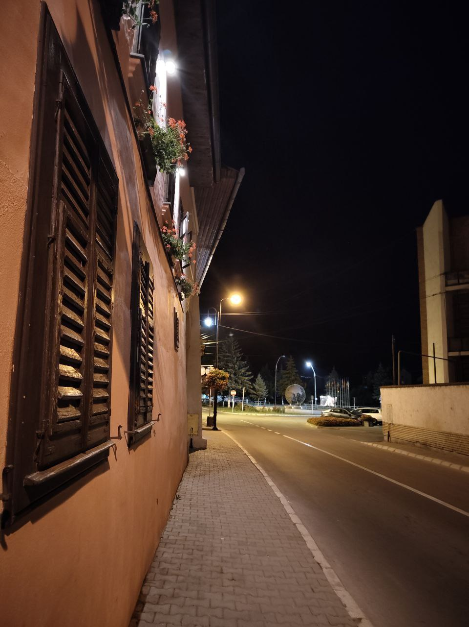
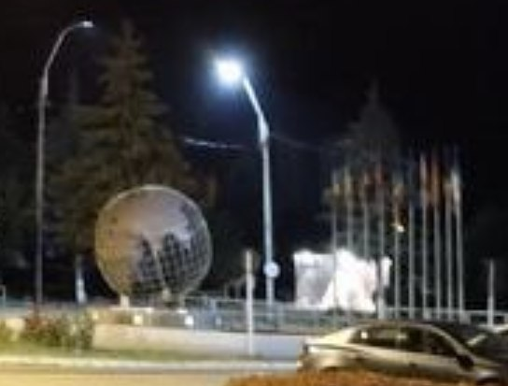
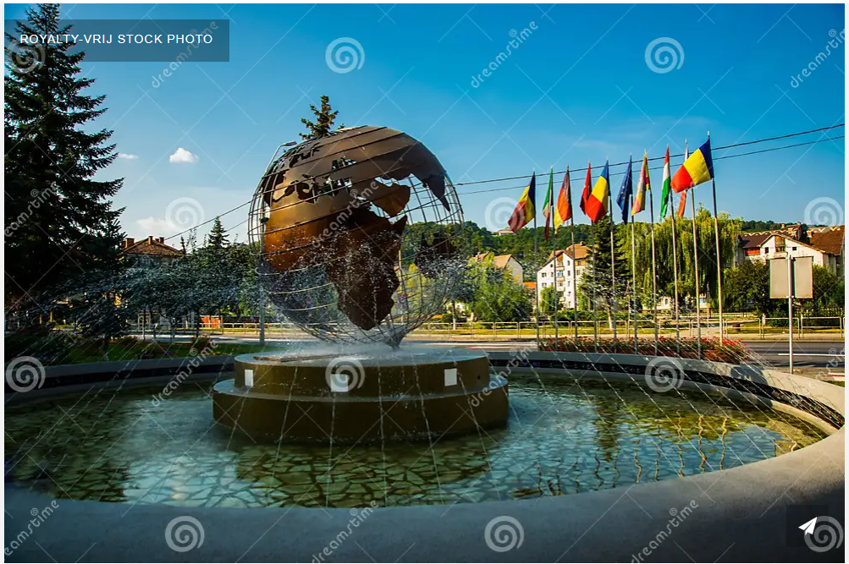
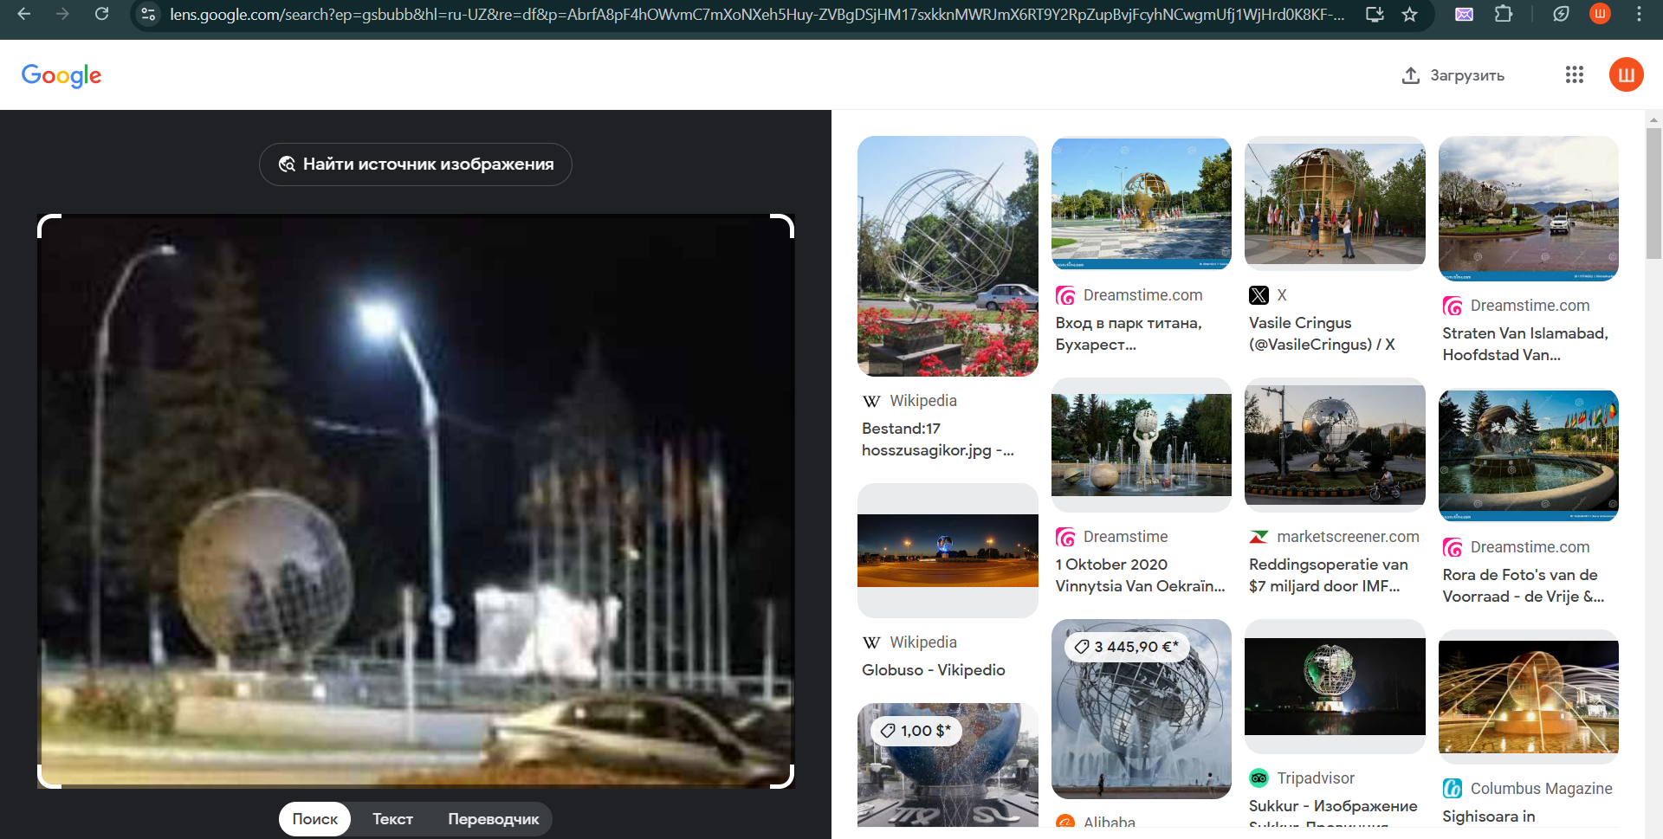
osint@bitwalls:~$ geoint -example
Find the coordinates of that photo

Slide 21
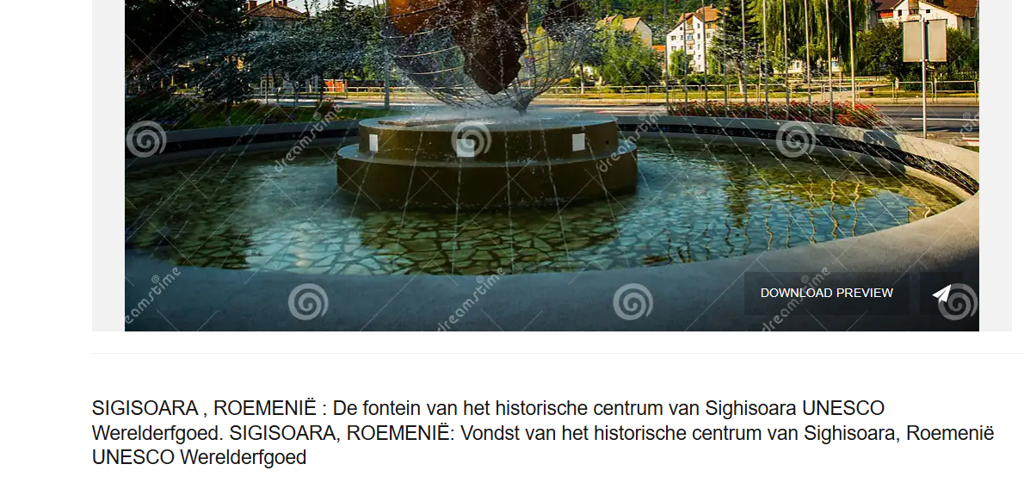
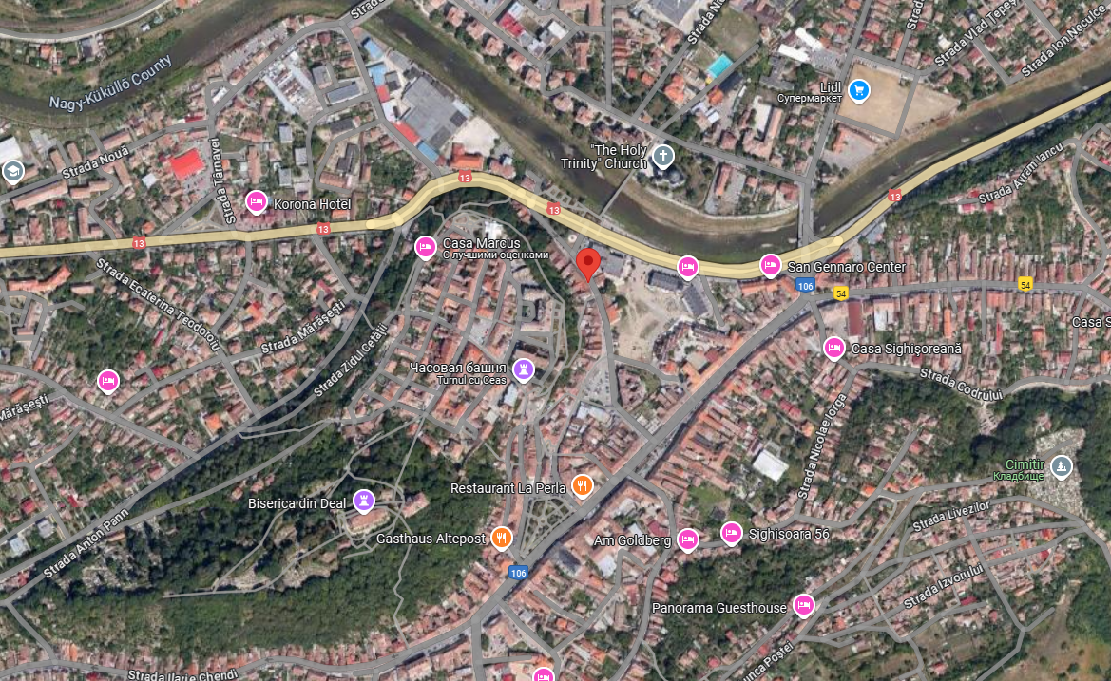
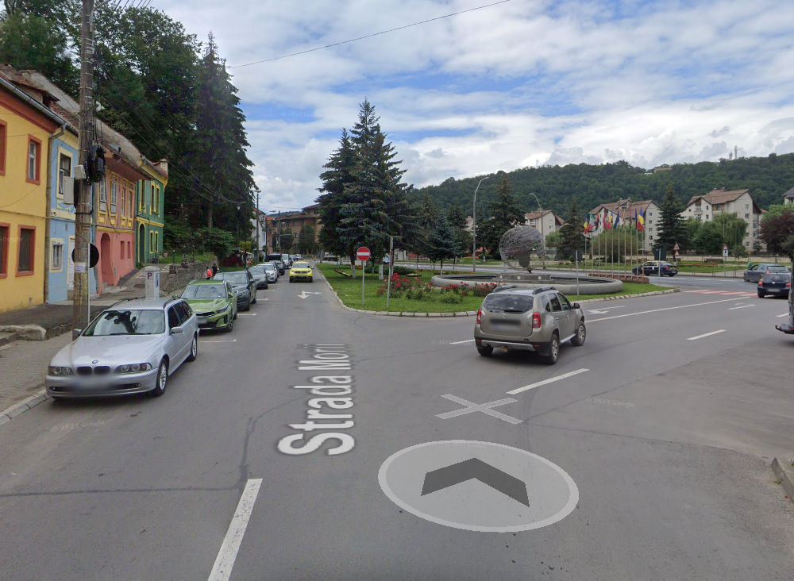
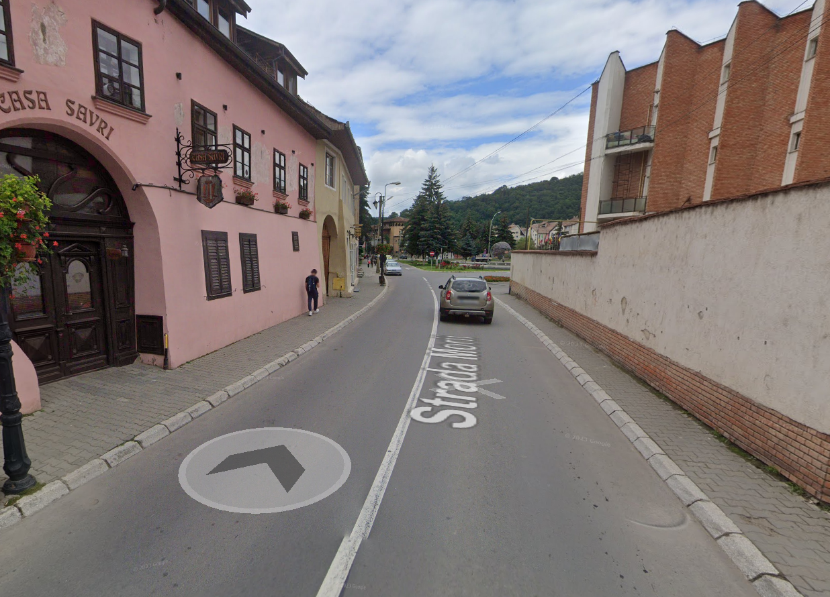
osint@bitwalls:~$ geoint example
Answer: 46°13'14.2"N 24°47'40.1"E

Slide 22
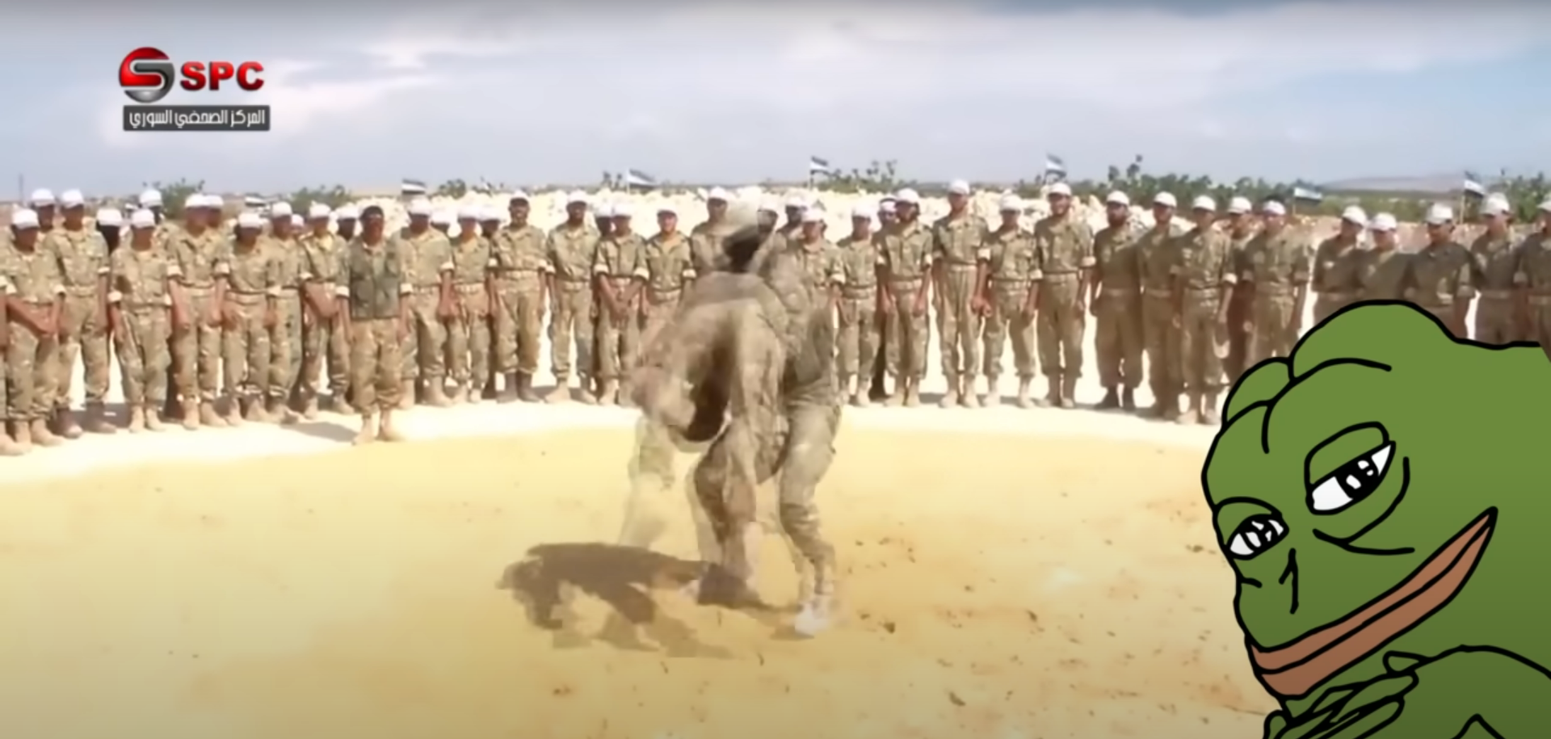
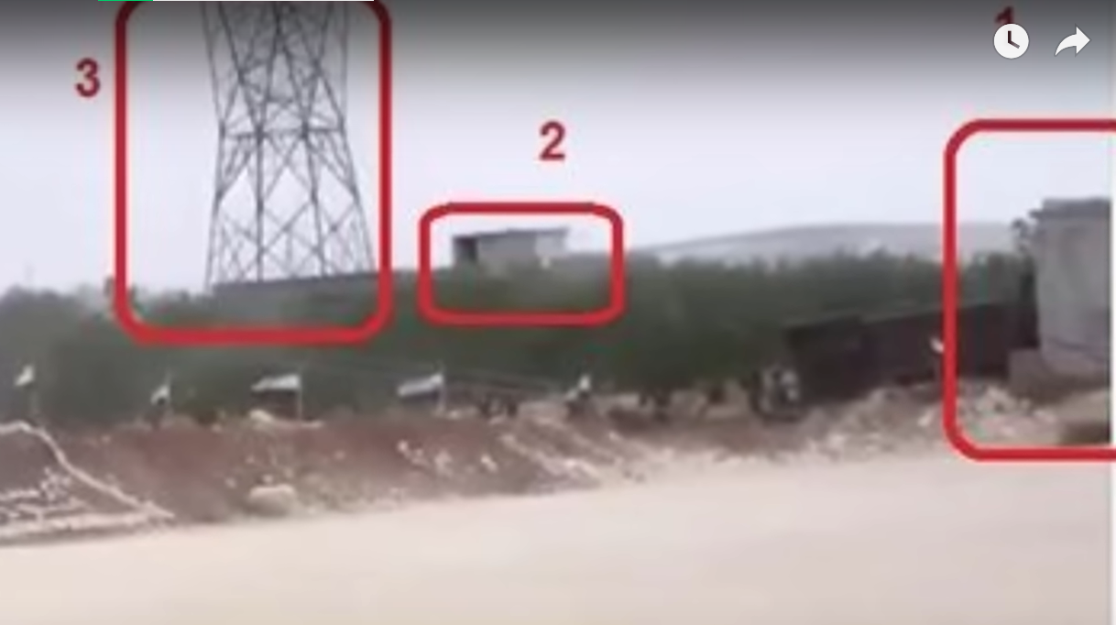
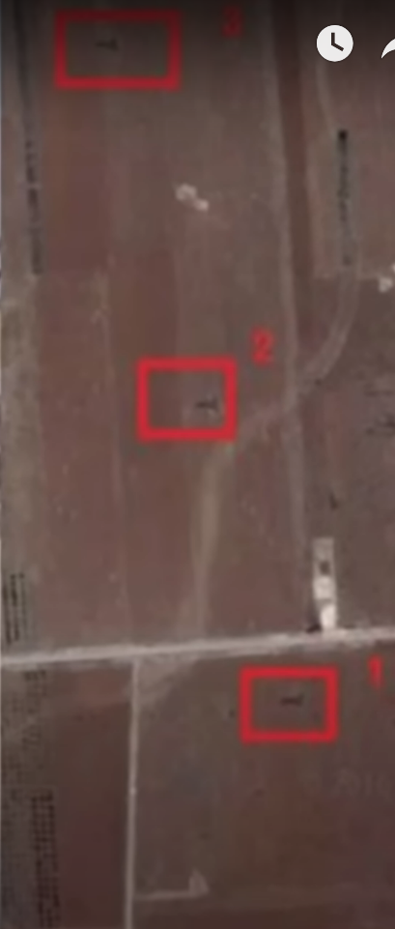
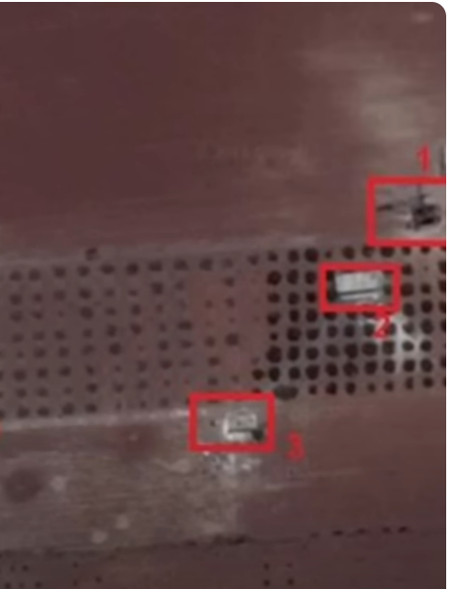
osint@bitwalls:~$ geoint –4chan
GEOINT in anti-terrorism actions

Slide 23
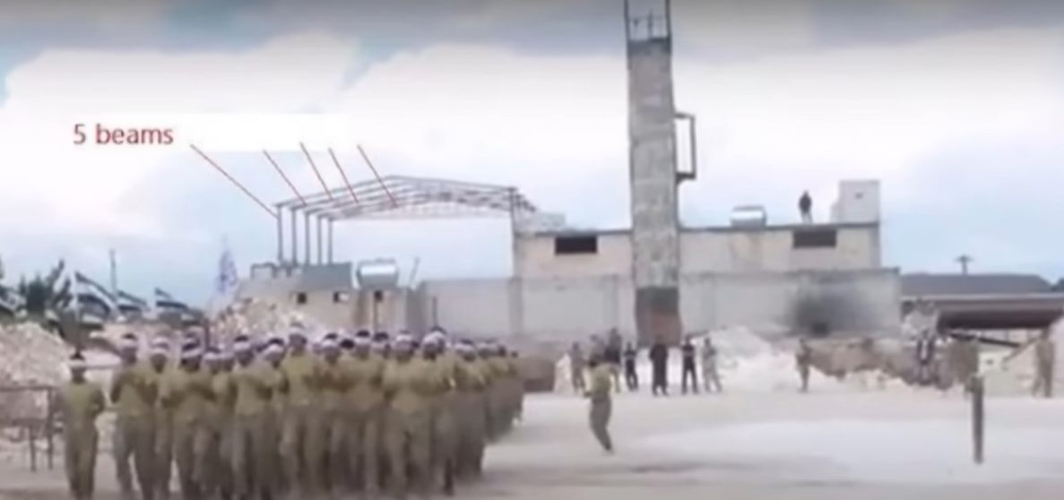
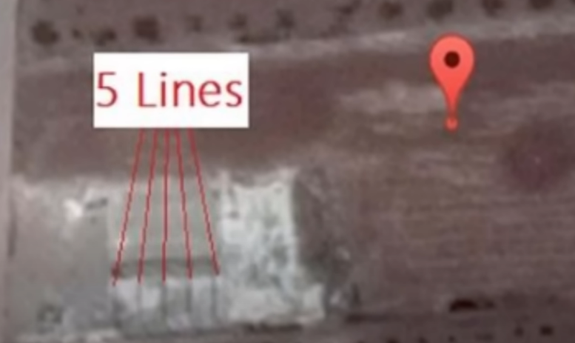
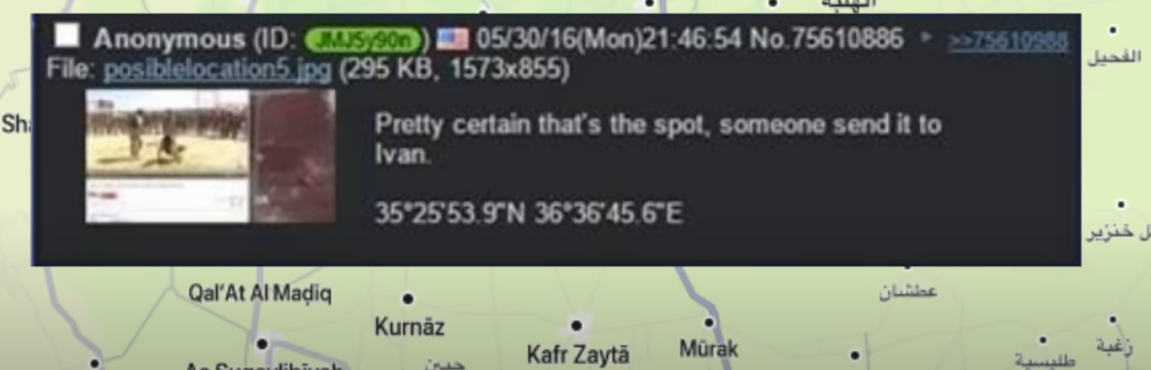
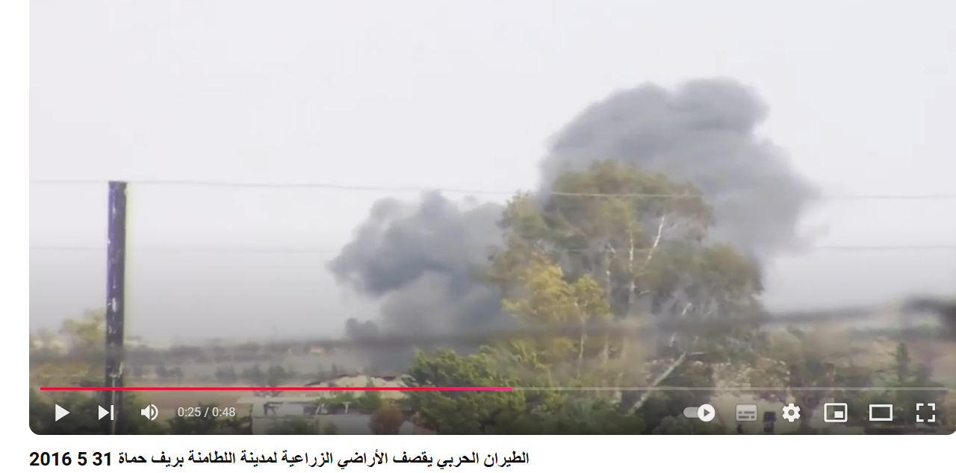
osint@bitwalls:~$ geoint –4chan

Slide 24
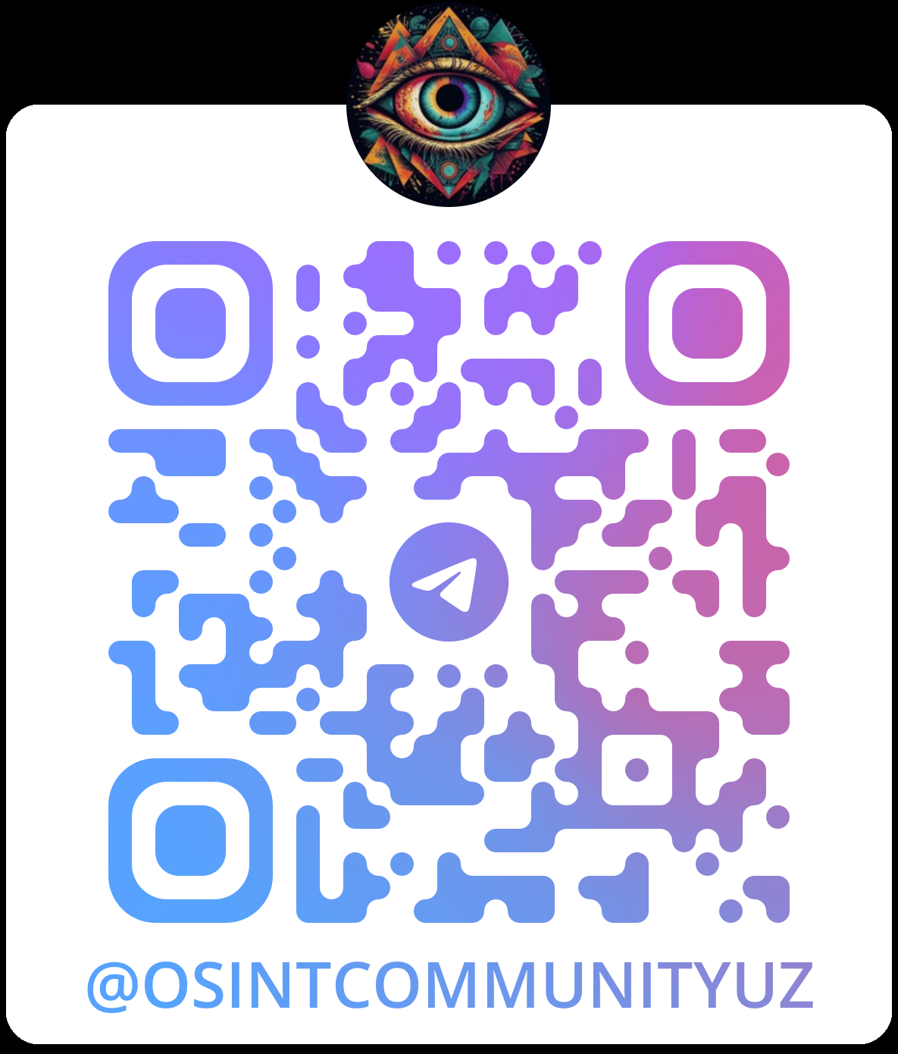
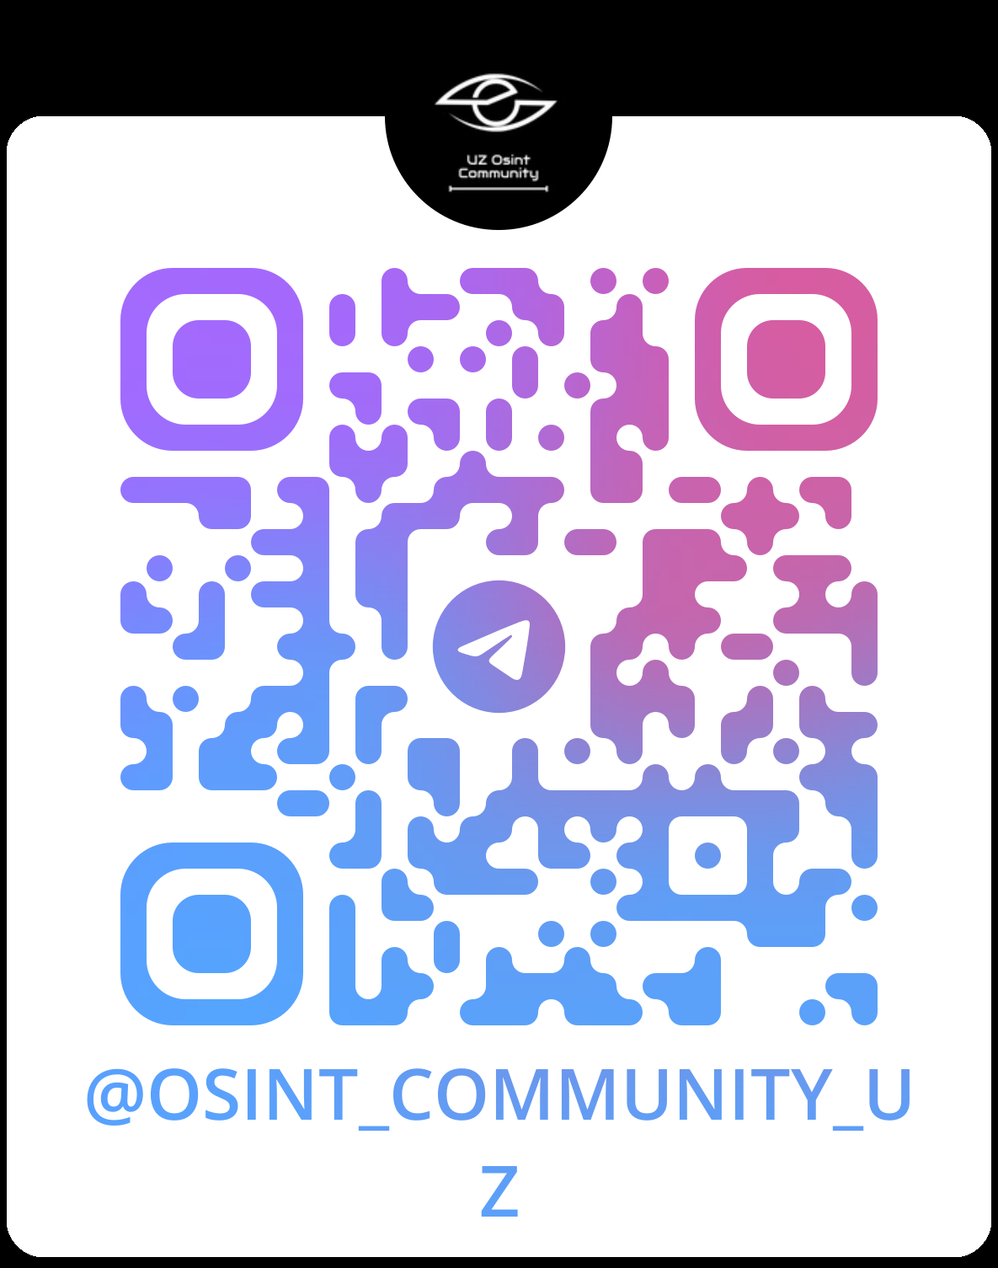
osint@bitwalls:~$ osint –channels
CHAT
CHANNEL

Slide 25
osint@bitwalls:~$ osint –conclusion
OSINT – is not just an IT discipline, it is not “probiv”. It`s more than just a discipline. OSINT is a skill that will help everyone not only on their career but in a daily life problems
We are was happy to see all of you,
thanks for your attention

